Slide 1
April 11, 2020
FEELME™ MUSIC&MOOD APP
FEELME™ MUSIC&MOOD APP
FEELME™ MUSIC&MOOD APP
FEELME™ MUSIC&MOOD APP
BY JAZ VICCARRO, DATA SCIENTIST, DEMOGRAPHER, MUSICIAN

Slide 2
Talking Points
DISCUSSION FLOW
Talking Points
Mission/Background
Problem Statement
Analysis
Machine Learning Insights
Future State
Talking Points
Talking Points

Slide 3

Problem Statement
STREAMING
STREAMING
STREAMING
"CAN SPOTIFY HELP ME FEEL A CERTAIN WAY?"
"CAN THERE BE A WAY TO IMPROVE MY SPOTIFY RECOMMENDATIONS?"

Slide 4
$99/year
HOW MUCH CONSUMERS ARE WILLING TO SPEND FOR SPOTIFY
$9.99/monthly
$4.99/monthly student
TYPICAL AMOUNT SPENT FOR STREAMING SERVICES

Slide 5

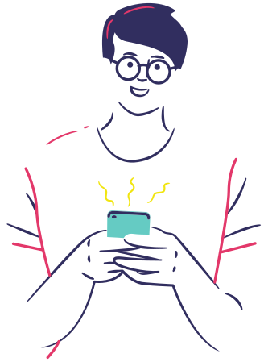
SPOTIFY STREAMING DATA USER PROFILE
John
Janeessan
1-YEAR WORTH OF DATA
over 30,000 streams tracked
EMOTIONAL PROFILE
Works in tech, Anxiety, Imposter Syndrome, dates online

Slide 6
HIGH END
HOW MUCH DOES IT COST ME TO SEE A THERAPIST?
$250 per session
LOW END
$25-50 copay
ACCORDING TO GOOGLE DATA, AVERAGE COST OF THERAPIST

Slide 7




Project Pipeline
API REQUEST
DATA MINING
ANALYSIS
.
.
MACHINE LEARNING
DATA SECURITY

Slide 8
DEMOGRAPHICS & SEGMENTATION
Content-Based Recommendations
vs.
User-Based Recommendations
Large scale analysis = technical debt
Factors to Consider
MARKET NEED
Factors to Consider
Factors to Consider
Factors to Consider
Comfort level with introspection
Competitors
PRIVACY, SECURITY, PROVENANCE
Presentations are communication tools that can be demonstrations.

Slide 9
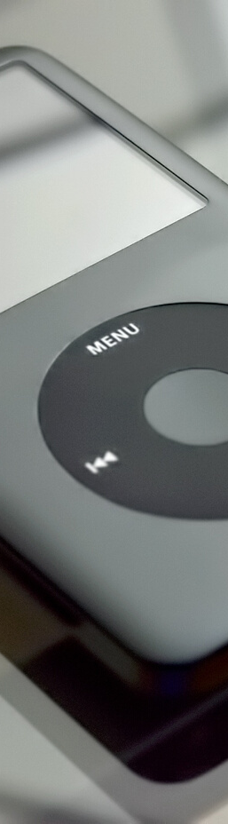
Analysis
Analysis
Analysis
Analysis
ASSESSING THE USER LANDSCAPE

Slide 10
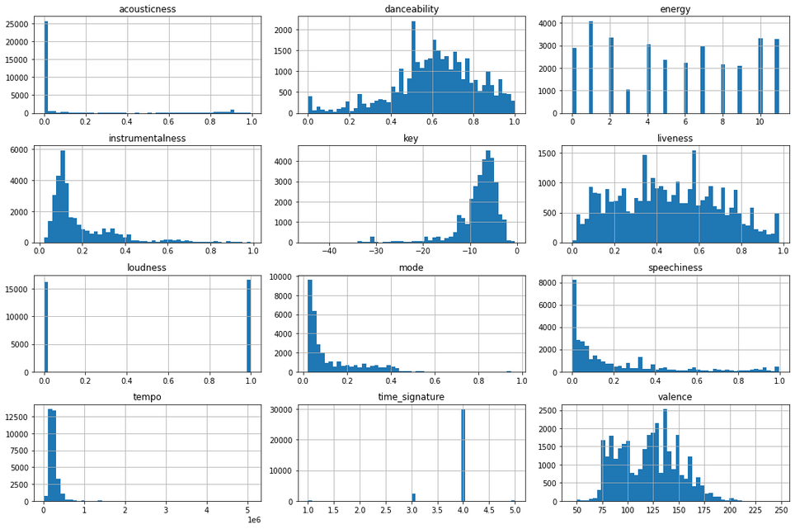
StreamingData

Slide 11
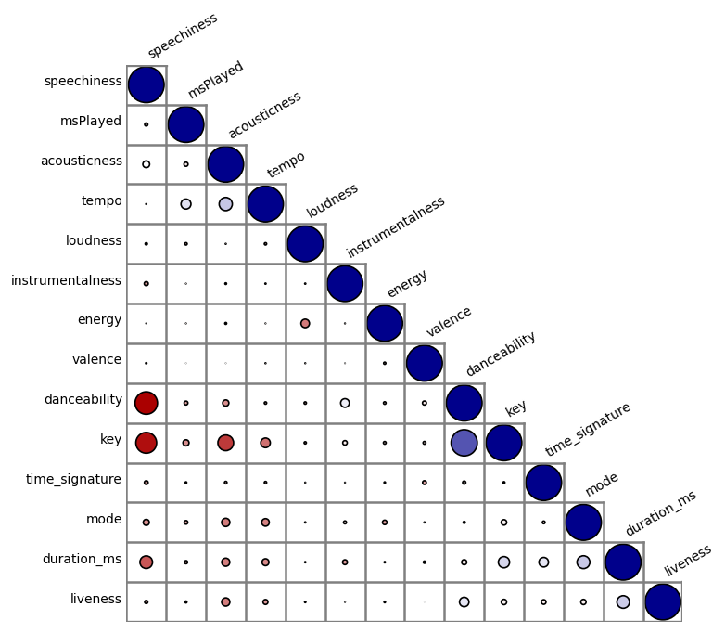
Audio Features
Audio Features
Audio Features
Audio Features

Slide 12
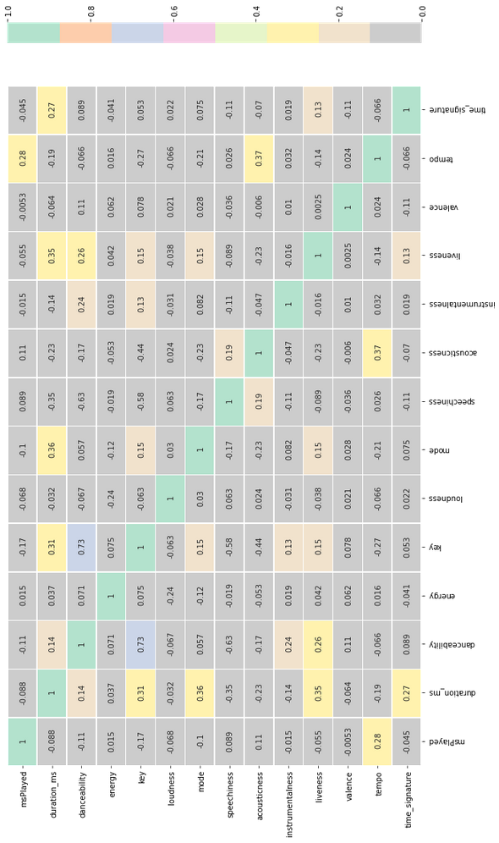
Audio Features
Audio Features
Audio Features
Audio Features

Slide 13

Machine Learning

Slide 14


KMeans
vs.
DBSCAN

Slide 15




NLP
&
Sentiment

Slide 16



ISSUES
&
NEXT STEPS

